Slide 1

Welcome to the Global Nutrition Report
and All-Party Parliamentary Group on Nutrition for Growth online event

Slide 2
2020 Global
Nutrition Report
Action on equity to end malnutrition
Thursday 18th June 2020
Professor Renata Micha, RD PhD FAHA
Co-Chair, Independent Expert Group of the Global Nutrition Report
Notes:
Talking points:
Thank you everyone for joining us.
I am Renata Micha, one of the two co-chairs of the Independent Expert Group of the Global Nutrition Report.
It is with great pleasure that I will be presenting you the 2020 Global Nutrition Report.
This year’s report highlights action on equity to end malnutrition.
[NEXT SLIDE]

Slide 3
About the Global
Nutrition Report
Notes:
Talking points:
Before I take you through the key findings of this year’s report, I wished to give everyone a brief overview of what the Global Nutrition Report is about.
[NEXT SLIDE]

Slide 4
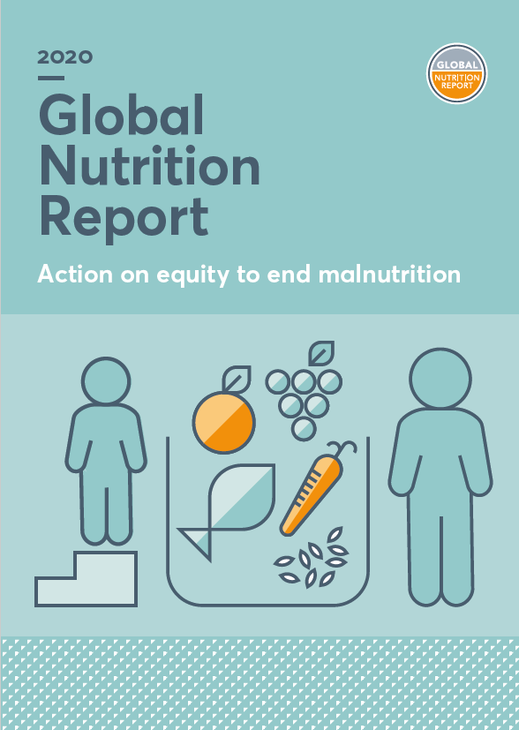
About the Global Nutrition Report
The world’s leading independent assessment of the state of global nutrition
The Global Nutrition Report was conceived following the first Nutrition for Growth (N4G) Initiative Summit in 2013 as a tool to track stakeholders’ commitments and inspire action.
Its vision is
A world free from malnutrition
in all its forms.
Its mission is
To drive greater action to end malnutrition in all its forms.
Notes:
Talking points:
The global nutrition report was conceived following the first Nutrition for Growth Summit in 2013 to track stakeholder* commitments and inspire action.
Today, it represents the world’s leading independent assessment of the state of global nutrition.
We provide the best available data, in-depth analysis and expert opinion rooted in evidence to help drive action on nutrition where it is urgently needed.
[NEXT SLIDE]
*governments, businesses, civil society, the UN and donors
Notes from website:
The Global Nutrition Report was conceived following the first Nutrition for Growth Initiative Summit (N4G) in 2013 as a mechanism for tracking the commitments made by 100 stakeholders spanning governments, aid donors, civil society, the UN and businesses. The following year, the first of these annual reports was published.
Today, the Global Nutrition Report is the world’s leading independent assessment of the state of global nutrition. It is data-led and produced independently each year to cast a light on where progress has been made and identify where challenges remain. The report aims to inspire governments, civil society and private stakeholders to act to end malnutrition in all its forms. It also plays the important role of helping hold stakeholders to account on the commitments they have made towards tackling malnutrition.

Slide 5


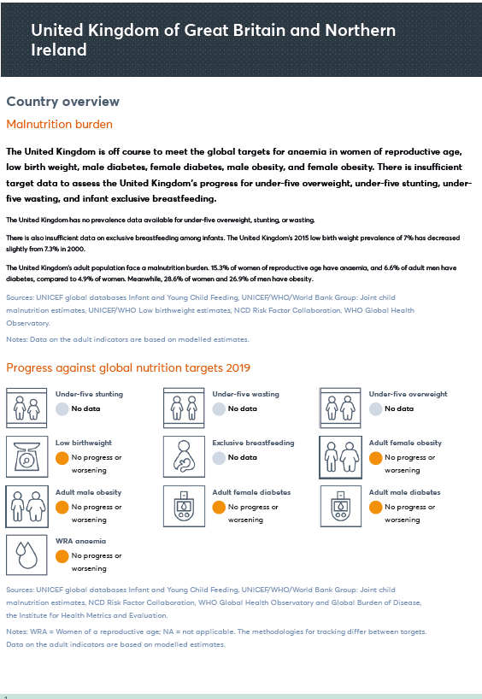
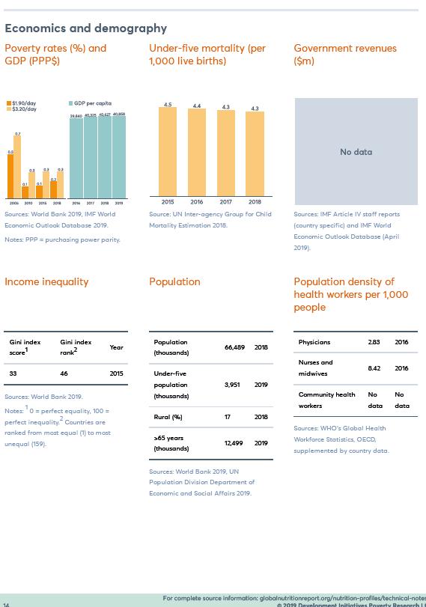
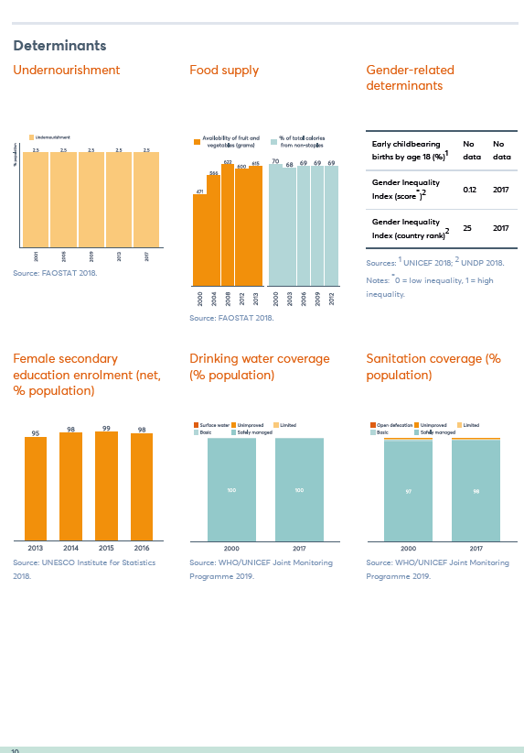
Nutrition Accountability Framework
The Global Nutrition Report as a key accountability mechanism
Stakeholders
Accountability
Priority Setting
Data storage
GNR
Governments
Data collection
Reporting
Advocacy
Businesses
Civil society
Philanthropic organisations
Data analysis
Notes:
Talking points:
One of the key functions of the GNR is to track progress against the global nutrition targets and the commitments made by stakeholders worldwide to reach them.
Given this important mandate, the GNR has a central role to play in leading and coordinating a much needed strengthened nutrition accountability framework.
This would be in partnership with other key existing accountability mechanisms, to hold governments, businesses, civil society, and philanthropic organizations accountable.
Strengthening global nutrition accountability surveillance is essential if we wish to inform priority-setting, ensure the appropriate actions are being taken and tackle immense nutrition-related health, economic and environmental burdens.
[NEXT SLIDE]
Notes:
AM: Accountability Mechanisms
Recommendations from the Accountability WG proposal
Given the above landscape the Accountability WG proposes the following:
Form an independent, coherent, streamlined, unified, well-financed and cost-effective “Nutrition Accountability Framework”, formed by the Global Nutrition Report and other key existing “Accountability Mechanisms”.
The GNR will lead, coordinate and implement recommendations that follow, contingent on available funds and resources (see section on Financing below). The GNR should also collaboratively lead a nd implement accountability criteria and mechanisms for constituencies that currently do not have an accountability mechanism in place.
Leverage and realign existing “Accountability Mechanisms” to enable better central coordination and analysis of data. Although several different “accountability mechanisms” exist that serve distinct and/or common purposes and priorities, there is a clear need to bring those together, identify requirements and areas of improvement/focus, maximize use of resources, avoid duplication of effort and minimize reporting burden. This should allow for the nuances of different accountability mechanisms whilst ensuring cohesion within one structure.
The GNR and the “Accountability Mechanisms” should jointly establish common principles for improving global nutrition accountability surveillance based on an evidence- and consensus-based processes following established criteria (e.g., Delphi method).
Harmonize -to the extent possible- the methodology, design, collection, processing and reporting of data by each of the accountability mechanisms; the GNR should be the central repository of all data and be responsible for the analysis and dissemination of all findings in a single place.
Create a publicly accessible and interactive database of commitments and actions that can be used to generate key accountability indicators.
Develop and validate accountability indicators that can be standardized, collected and monitored at a local, national, sub-regional, regional, and global level.
Accountability frameworks should be institutionalised. The commitments should not rely on individuals, but institutions should ensure a monitoring system is in place for sustainability of tracking and reporting.
Expand nutrition accountability surveillance in all countries worldwide and for all relevant stakeholders, ensuring it becomes an annual reporting requirement with appropriate technical support and guidelines.
Disseminate the findings of nutrition accountability surveillance activities, including feedback from stakeholders and end users.
Ensure sustainability of global nutrition accountability surveillance through leveraging existing resources and infrastructures, and continuous funding.
Continuously monitor and evaluate the "Nutrition Accountability Framework” in order to drive better data, stronger commitments, and enable faster, efficient, effective and real-world adaptations.

Slide 6
Key findings from the
2020 Global Nutrition Report
Notes:
Talking points:
And now back to the 2020 report – this year’s GNR focuses on the need to tackle malnutrition through action on equity.
Why action on equity?
Because we will never end malnutrition, unless everyone is treated fairly and according to need.
[NEXT SLIDE]

Slide 7



The 2020 GNR in the context of Covid-19
Urgent need for equitable, resilient and sustainable food and health systems
Covid-19 does not treat us equally
The way forward
►Coordination
► Financing
► Accountability
Covid-19 exposes the vulnerability of our food systems
Covid-19 exposes deadly healthcare disparities
Notes:
Talking points:
Although the 2020 Global Nutrition Report was written before the current coronavirus pandemic, its emphasis on nutritional well-being for all, particularly the most vulnerable, has a heightened significance in the face of this new global threat.
The need for more equitable, resilient and sustainable food and health systems has never been more urgent.
Covid-19 does not treat us equally: On one hand, undernourished people have weaker immune systems, that may put them at greater risk of severe illness due to the virus. At the same time, poor metabolic health, including obesity and diabetes, has been strongly linked to worse Covid-19 outcomes, such as risk of hospitalization and death. Focusing on nutritional wellbeing for all should be at the center of our response.
Covid-19 exposes the vulnerability of our food systems: People who already suffer as a consequence of inequities, including the poor, women and children, the unsheltered, are particularly affected by the impact of containment measures, which caused food shortages and inaccessibility to food assistance programmes they rely upon. Millions in formerly food-secure regions have fallen into food insecurity (with the threat that hunger and malnutrition could double in 2020). We must ensure that there is enough healthy food, distributed fairly, to cover basic nutrition needs – especially for the most vulnerable.
Covid-19 exposes deadly healthcare disparities: Even the strongest health systems are struggling with high healthcare costs and a shortage of medical personnel, equipment and facilities. We need to fully integrate nutrition into our health systems to save lives and reduce healthcare spending, while ensuring that no one is left behind.
The way forward is through strengthened coordination, financing and accountability: Looking beyond the present emergency, there is a need for well-functioning, well-funded and coordinated preventive public health strategies that pay attention to food, nutrition, health and social protection. We must learn from the challenges posed by Covid-19 and turn them into opportunities to accelerate actions needed to address malnutrition in all its forms.
[NEXT SLIDE]

Slide 8

Nutrition inequity: our defining challenge
Injustices in food and health systems hold people back from healthy diets and lives
Social determinants are drivers of inequity…
… that can lead to inequalities
in nutrition outcomes
Basic determinants
Underlying determinants
Globally, 1 in 9
people is hungry
or undernourished
Globally, 1 in 3
people is overweight or obese
Socioeconomic and
political context
Everyday circumstances
and norms
Human capital or potential
Environments
Social position
Processes of unfairness, injustice and social exclusion start at the basic level and extend to the underlying level
Notes:
Talking points:
Inequity is our defining challenge in ending malnutrition in all its forms.
Most people cannot access or afford a healthy diet or quality nutrition care.
[ANIMATION-click]
This access is hindered by unjust systems and processes, holding people back from healthy diets and lives.
Unfairness, injustice and social exclusion are determined by social factors, such as wealth, sociocultural perception of age, gender and ethnicity, that in turn impact everyday living conditions.
These social determinants are the root causes of nutrition inequity that can lead to unequal nutrition outcomes.
[ANIMATION-click]
For example, poorer people may not be able to afford healthy food, or such options may not even be readily available in their communities, leading to worse nutrition outcomes.
This in turn can lead to more inequity –as a sickened person may be less able to work- perpetuating a vicious cycle.
The consequences of nutrition inequity are evident.
We live in a world where 1 in 9 people are hungry or undernourished, and 1 in 3 people are overweight or obese.
[NEXT SLIDE]
****Notes****
For reference from Chapter 1:
The basic level of the framework is particularly useful for highlighting how someone’s social position can significantly affect their human capital and potential.
At the underlying level, nutrition inequity is caused by the way that people’s everyday social, psychological/behavioural and material circumstances interact with their wider environments.
While a focus on inequality is about understanding the differences in nutrition outcomes, such as diet and disease patterns, among different population groups, looking at inequity shifts the focus to the underling system and processes that generate unequal distribution of outcomes.
For reference from the Glossary:
Equality & inequality
Inequality refers to differences, variations and disparities in health and living conditions among people (individuals and population groups) that are the outcome (or consequence) of unjust systems and processes that structure everyday conditions (see “Equity and inequity”). Nutrition inequalities are differences in people’s nutritional outcomes, such as dietary intakes, nutritional status and related conditions/ diseases, influenced for example by location, age, gender, ethnicity and wealth.
Equity and inequity
Equity focuses on opportunities rather than outcomes and encompasses the idea of fairness or justice. Inequity adds a moral dimension, and can be defined as ‘unfairness of opportunity’, or lack of equitable access to systems and processes that structure everyday conditions, leading to inequalities (or unequal outcomes/ consequences). In other words, equality of opportunity, or equity, influences equality of outcome. Nutrition equity here focuses on opportunities and barriers within food systems and health systems that impact access to healthy, affordable food, and quality nutrition care, thus leading to unequal nutrition outcomes (or nutrition inequalities).

Slide 9
Snapshot of nutrition
in the UK
Notes:
Talking points:
Let’s now have a look at the state of nutrition in the UK.
[NEXT SLIDE]

Slide 10
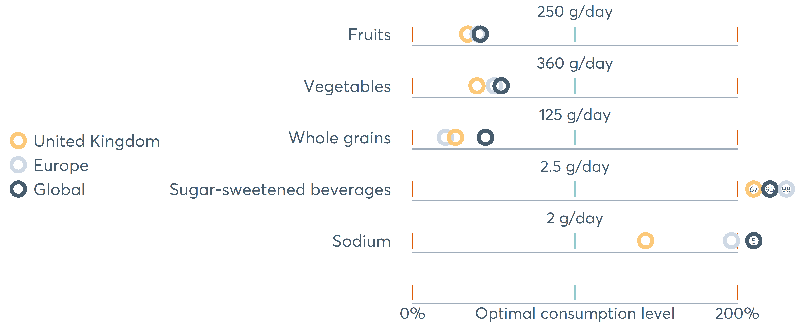
Diets are suboptimal everywhere
Fruit and vegetable consumption is less than 3 servings/day in the UK
Notes:
Talking points:
Diets are suboptimal everywhere, including the UK.
Here we see how current average intake levels in 5 key foods and nutrients compare to optimal levels of consumption -that is levels associated with minimum disease risk- globally, in Europe and the UK.
The middle line shows the optimal level; for fruits for example, the optimal level is 250 g/day.
If intake -denoted by the colored circle- lies to the left of the middle line, then it is suboptimal for protective diet factors, such as for fruits. If it lies to the right of the middle line, then it is suboptimal for harmful diet factors, such as for sodium.
People are not eating enough healthy food and are eating too much of unhealthy food.
In the UK adults consume on average less than 3 servings of fruits and vegetables per day, half of the recommended 5 a day .
Diets of most children and adolescents also remain poor, with tremendous consequences for metabolic diseases and other diet-related illness later in life given childhood is a critical period to establish lifelong eating habits.
Achieving healthy dietary changes to improve our health is an urgent priority.
[NEXT SLIDE]
********
Source: Global Burden of Disease, the Institute for Health Metrics and Evaluation. Notes: Men and women aged 25 and older. Chart ordered by foods/nutrients. TMREL: theoretical minimum risk exposure level.
(186 countries represented)
Scale: It is % based on the optimal consumption in grams. So, for example, looking at Whole Grain, the far left is 0g/d and the far right is 250g/d.
Fruit - 84.9g/d
Veg - 142.5g/d
Using 100g/serving:
Fruit - 0.85serving/day
Veg - 1.43serving/day
The WHO, British Nutrition Foundation and FAO all follow 80g. I have given these numbers below also.
Using 80g/serving:
Fruit - 1.06serving/day
Veg - 1.78serving/day

Slide 11
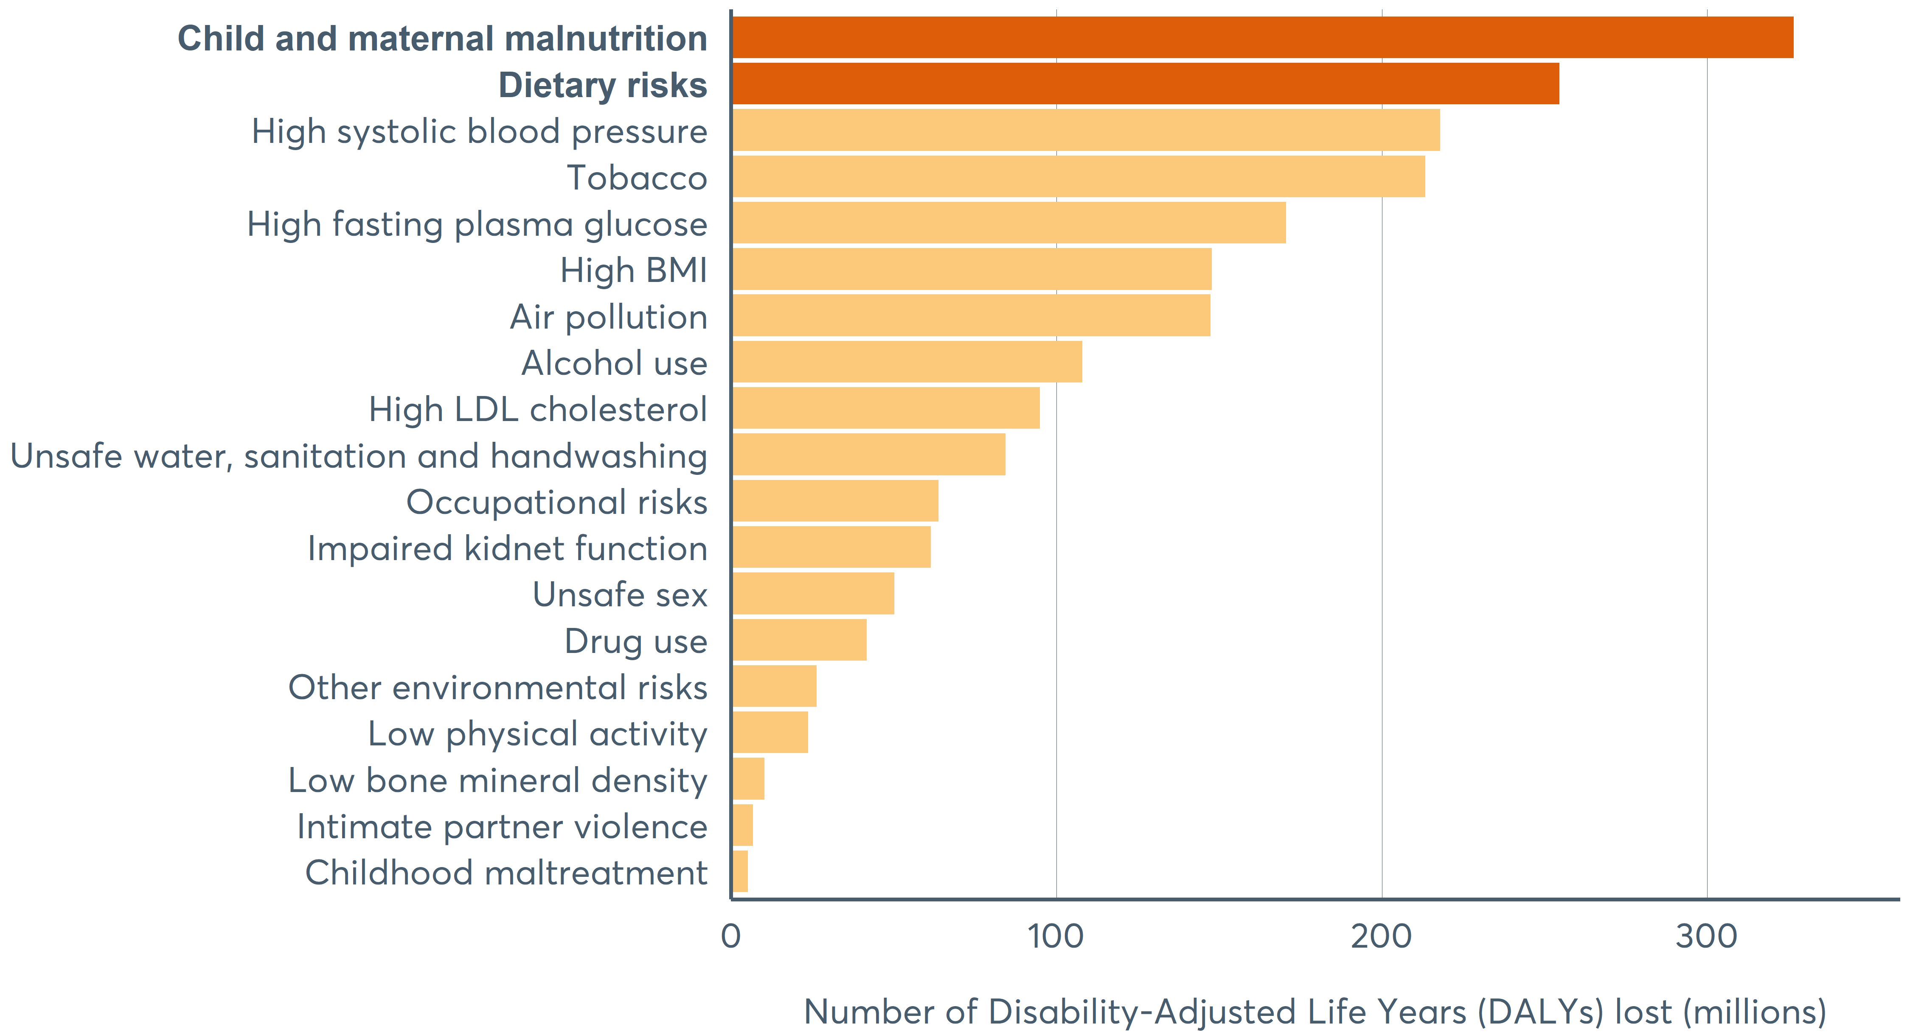
Poor diet: #1 cause of poor health globally
Greatly exceeding burdens attributable to traditional risk factors
Notes:
Talking points:
Poor diet is the number one cause of poor health and death worldwide, with similar patterns seen in nearly all parts of the world.
Burdens attributable to poor diet exceed the burdens attributable to many other major global health challenges and traditional risk factors, such as systolic blood pressure and blood cholesterol.
For decades, health systems and clinicians have focused on the medical, drug treatment-based model of disease that ignores fundamental causes such as diet and lifestyle.
The consequences of this narrow approach are evident: the global nutrition crisis that is now sweeping the world.
[NEXT SLIDE]
Notes:
The major global impacts of food insecurity and undernutrition have long been recognized, for which tremendous diet-related burdens of noncommunicable chronic diseases (NCDs) have now emerged.
Even modest dietary changes are associated with improvements in maternal and child undernutrition and micronutrient deficiencies as well as meaningful reductions in NCDs and associated risk factors such as obesity.

Slide 12

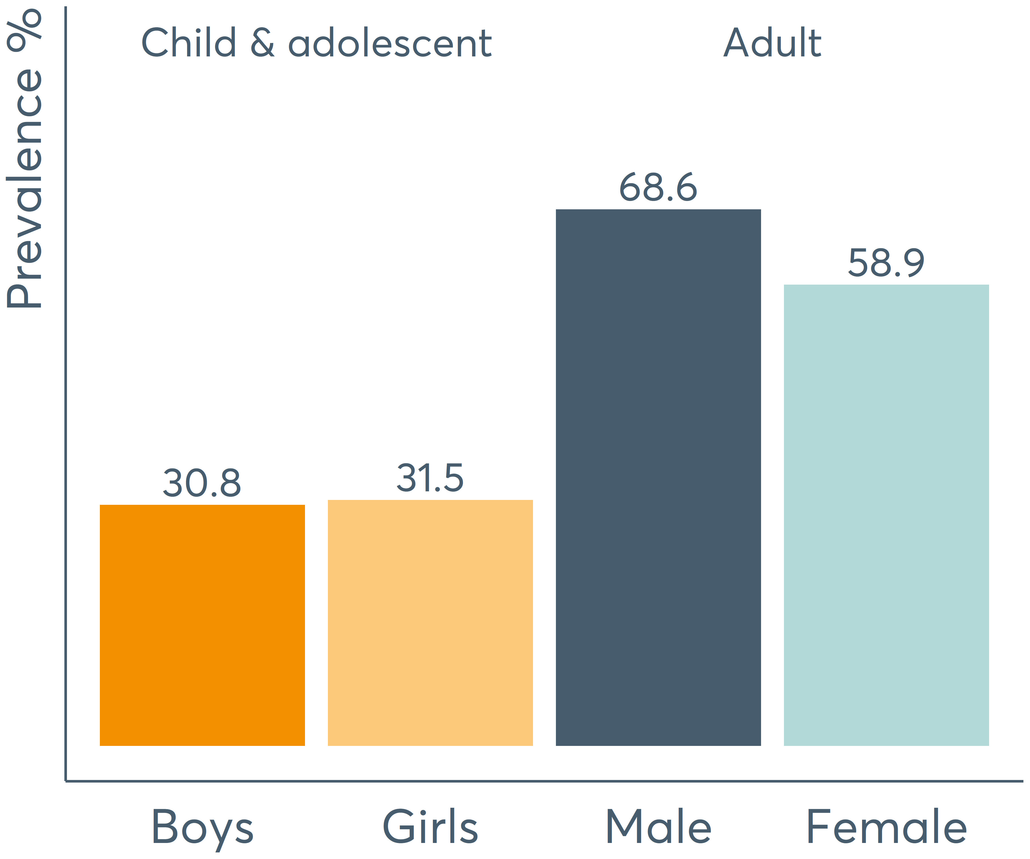
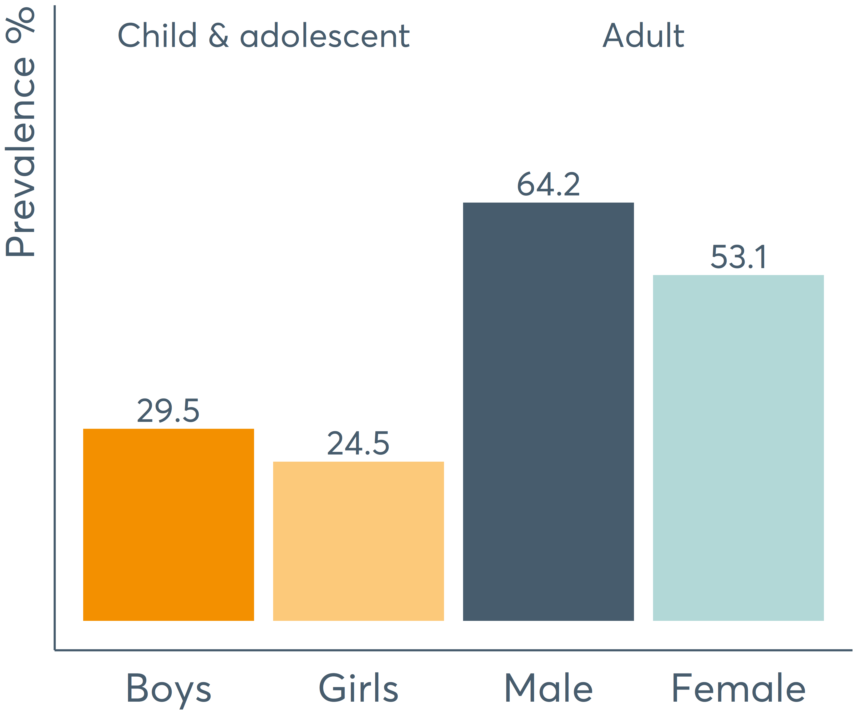
Overweight and obesity at alarming levels
1 in 3 children and 2 in 3 adults are overweight or obese in the UK
Overweight and obesity in the UK
Overweight and obesity in Europe
Notes:
Talking points:
Perhaps the most pressing nutrition challenge around the world is the accelerating rate of diet-related chronic diseases, including obesity which is a disease itself and a major risk factor for other diseases such as diabetes, cardiovascular disease and some cancers.
Overweight and obesity are on the rise, and no country worldwide is spared.
Looking at the UK, 1 in 3 children and 2 in 3 adults are overweight or obese.
UK’s progress in tackling overweight and obesity has been slow. Compared to Europe, the UK is a bit behind.
Reversing the obesity epidemic, a diet-related disease, would lessen the burden on our healthcare systems, as obesity is not only one of the costliest health conditions but also a major risk of Covid-19 hospitalizations and complications.
In the UK, the overall cost of obesity to wider society is estimated at 27 billion pounds/ year and is projected to reach almost 50 billion pounds by 2050.
[NEXT SLIDE]
Notes:
In the UK as of 2016, around 1/3 (31%) of children and adolescents (5-19) were overweight or obese with 2/3 of adults (18+) (~64%) overweight or obese.
https://www.gov.uk/government/publications/health-matters-obesity-and-the-food-environment/health-matters-obesity-and-the-food-environment--2#:~:text=The%20overall%20cost%20of%20obesity,%C2%A349.9%20billion%20per%20year.

Slide 13


Nutrition equity: our defining opportunity
Everyone deserves access to healthy food and quality nutrition care.
This is not simply a matter of personal choices.
Food and health systems need to be transformed
Address inequities in
food systems and make healthy, sustainable food the most accessible and affordable choice for all
Fully integrate nutrition in health systems and make nutrition care, preventive and curative, universally available
Notes:
Talking points:
Nutrition equity is our defining opportunity to fix the global nutrition crisis.
Everyone deserves, and should have, access to healthy, affordable food and quality nutrition care, which is not simply a matter of personal choices.
Governments, businesses and civil society are accountable for healthier and more equitable food and health systems, and must step up efforts.
We need to remove systematic barriers (unjust differences between people) and create opportunities for everyone to achieve healthy diets and healthy lives through pro-equity nutrition actions.
Healthy, sustainable food should be the most accessible, affordable and desirable choice for all.
Nutrition care, preventive and curative, should be made universally available within our health systems.
Now is the time to act in coordination and make nutrition central to any emergency or long-term response.
[NEXT SLIDE]
Notes:
The need for more equitable, resilient and sustainable food and health systems has never been more urgent if we want to prepare our communities for future shocks and avoid a reversal of gain.

Slide 14
How can we make our health systems more equitable?
Notes:
Talking points:
So how can we make our health systems and food systems more equitable?
The 2020 GNR covers both, but the present presentation focuses on health systems from a global perspective.
[NEXT SLIDE]

Slide 15
Leadership and governance
Countries are not prepared to fight both sides of malnutrition at the same time
Percentage of countries
with actions related to global nutrition targets
in health sector plans
72.0%
72.0%
70%
66.7%
66.7%
60.0%
60%
60.0%
56.3%
56.3%
55.6%
55.6%
55.6%
55.6%
53.8%
53.8%
52.0%
52.0%
Low-income
50%
46.2%
46.2%
43.8%
46.2%
43.8%
42.3%
Lower-middle-income
40%
40.7%
37.0%
34.6%
31.3%
Upper-middle-income
31.3%
29.6%
30%
26.9%
26.9%
25.0%
High-income
20%
18.8%
12.0%
10%
6.3%
4.0%
4.0%
0%
Anaemia
Exclusive
breastfeeding
Childhood
stunting
Childhood
overweight
Adolescent and adult
overweight
Diabetes
Notes:
Talking points:
Leadership and governance form the core of a strong health system and are critical to addressing nutrition inequities through strengthened policy frameworks, oversight and accountability.
Looking at the inclusion of actions related to global nutrition targets in health sector plans by country income,
[ANIMATION-click]
we see that the focus of lower-income country plans is mainly on countering undernutrition, especially through promoting exclusive breastfeeding, and reducing anemia and stunting.
[ANIMATION-click]
In contrast, high-income countries focus more on overweight, obesity and diabetes.
It is important for lower-income countries to not overlook diet-related chronic diseases.
[ANIMATION-click]
Higher-income countries should also recognize the persistence of anemia and low birth weight still experienced in vulnerable populations.
The low level of attention paid to breastfeeding in high income countries is concerning given its role as a ‘double-duty action’.
Countries need to ensure that their policy instruments are fit to tackle both sides of malnutrition, particularly when these coexist.
[NEXT SLIDE]
Notes
Inclusion of goals, targets or indicators related to the global nutrition targets in health sector plans across 94 countries by country income, 2016–2017.
Of 167 countries reporting nutrition policies in 2016–2017, 95 reported health sector plans with integral nutrition objectives.
Generalisations may be affected by the lack of representativeness within and across country income groups.
****Notes****
Inclusion of goals, targets or indicators related to the global nutrition targets in health sector plans across 94 countries by country income.
Of those, 94 (all but Niue) were classified by gross national income per capita as high- (25, 26.6%), upper-middle- (26, 27.7%), lower-middle- (27, 28.7%) and low- (16, 17.0%) income groups
It should also promote and ensure access of services by the most vulnerable, including marginalised or traditionally overlooked population groups. This is crucial to meeting the global nutrition targets.

Slide 16
Challenges in health systems
Nutrition care – preventive and curative – is not equitably integrated
within health systems
Integration of nutrition within health systems
Across each of the health system building blocks
Leadership
and governance
Health
workforce
Health
systems
financing
Access to
essential
medicines
Health services
delivery
Health
information
systems
Strong government coordination on nutrition is lacking
The number and distribution of trained nutrition professionals
is not equitable
Spending on nutrition represents a tiny portion of national health budgets
Important nutrition products and technologies are not readily available to all
Nutrition services are limited and focus most on undernutrition
Health records and national surveys are not optimised to assess nutrition
Notes:
Talking points:
As we saw, poor diet is the leading cause of poor health and death, and the rapid rise of diet-related chronic diseases is putting an immense strain on health systems and the wider society.
Yet, nutrition care is not equitably integrated within our health systems.
Leadership and governance: Strong government coordination on nutrition is often lacking, with only few countries having a designated coordinating nutrition unit.
Health workforce: The number and distribution of trained nutrition professionals is not equitable. Globally, the median number stands at only 2.3 per 100,000 people (0.9 per 100,000 people in Africa, while some countries have none).
Health system financing: Nutrition actions only represent a minuscule portion of national health budgets although they can be highly cost-effective or even cost-saving solutions in the long term (ex: promotion of breastfeeding as double-duty action, prescribing healthy foods)
Access to essential medicines: Important nutrition products and technologies are not readily available to all.
Health service delivery: Nutrition services are limited and largely focused on undernutrition.
Health information systems: Health records and checks are not optimised to assess nutrition. And there is a lack of national surveys comprehensively and routinely assessing diets and the nutritional status of populations.
[NEXT SLIDE]
****Notes****
WHO’s six building blocks of a health system provide a helpful framework for identifying key challenges and opportunities in the comprehensive integration of nutrition into health care.
Lack of development opportunities for frontline workers.

Slide 17
Opportunities in health systems
Universal health coverage is our chance to fully integrate nutrition
in health systems, save lives and reduce healthcare spending
Integration of nutrition within health systems
Across each of the health system building blocks
Leadership
and governance
Health
workforce
Health
systems
financing
Access to
essential
medicines
Health services
delivery
Health
information
systems
Full integration of nutrition care into national health sector plans
A greater number of equitably distributed nutrition professionals
Alignment of costed nutrition care plans with healthcare financing plans
Inclusion of nutrition products in essential medicines' lists and use of technologies
Integration of nutrition care
in health
service delivery, regularly monitored
Inclusion of nutrition into health records and public health surveillance systems
Notes:
Talking points:
To improve diets, save lives and cut healthcare costs, nutrition should be mainstreamed in health systems.
How do we do that?
Each of the identified challenges presents an opportunity.
Leadership and governance: Fully integrate nutrition care into national health sector plans.
Health workforce: Invest in human resources to increase the number of qualified nutrition professionals.
Health system financing: Develop and align costed nutrition care plans with healthcare financing plans, scaled up and sustained to cover all forms of malnutrition.
Access to essential medicines: Include nutrition-related health products like therapeutic foods and innovative technological solutions like digital nutrition counselling.
Health service delivery: Scale up nutrition services to prevent the root causes of ill health, including poor diets and physical inactivity.
Health information systems: Optimize health records and checks for nutrition care, and identify those in greatest need. Integrate nutrition in public health surveillance systems, to strengthen the evidence base and inform targeted priority-setting.
Transforming our health systems to fully integrate nutrition is not easy; but it’s an essential investment if we want to save lives and release the burden on our health systems and the wider society.
Good nutrition is central to a healthy life, and to addressing obesity, diabetes and other diet-related diseases. This is not going to be the last pandemic, and we need resilient populations.
[NEXT SLIDE]

Slide 18
What are the critical actions needed to achieve nutritional well-being for all?
Notes:
Talking points:
Nutritional well-being for all takes on a new urgency given the potential for a well-nourished population to better confront chronic diseases, pandemics and global shocks..
[NEXT SLIDE]

Slide 19




Critical actions to end malnutrition
Transform systems and target resources for faster and fairer progress
Build equitable, resilient and sustainable food and health systems
Invest in nutrition, especially in communities most affected
Focus on joint efforts – global challenges show how vital this is
Renew and expand commitments and strengthen accountability
Notes:
Talking points:
The report makes the case for governments, businesses and civil society to enable faster, more equitable progress towards ending malnutrition in four key ways:
Build equitable, resilient and sustainable food and health systems, to ensure that everyone has access to healthy affordable food, and quality nutrition care.
Expand financing, crucially for diet-related chronic diseases, and direct resources and programmes to the communities and populations most affected.
Focus on joint efforts by engaging and mobilizing all sectors to act now and target those most in need.
Leverage key moments to renew and expand commitments and strengthen accountability to monitor pledges and commitments.
[NEXT SLIDE]
For reference :
In essence the report makes the case for governments, businesses and civil society to enable faster, more equitable progress towards ending malnutrition in all its forms - an opportunity for us to invest in nutrition to preserve our future. in three key ways:
To drive the transformative change needed to achieve nutrition equity, and end malnutrition in all its forms, we must focus on three key areas: food systems, health systems and financing.
Health systems:
To save lives and cut healthcare costs, sectors must work in collaboration to mainstream nutrition as a basic health service through leveraging existing infrastructure and introducing new technologies.
Roll out nutrition services within health services by developing costed nutrition care plans, that should be scaled up and sustained to cover all forms of malnutrition, including overweight, obesity and other diet-related NCDs.
Invest in human resources to increase the number of qualified nutrition professionals and level out access to quality nutrition care.
Use a variety of health professionals and workers to alleviate inequities in access and enhance their performance through educational and development opportunities.
Include nutrition-related health products like therapeutic foods and innovative technological solutions like digital nutrition counselling, where appropriate – especially when working with more remote and harder-to-reach communities.
Optimise health records and checks for nutrition care, to deliver preventive and curative nutrition services and identify those in greatest need.
Commit to routine and systematic collection of equity-sensitive nutrition data at the community level, disaggregated by key population characteristics to strengthen the evidence base and inform targeted priority-setting.
Adequate nutrition is an essential defence strategy to protect populations against epidemics, release the burden on our health systems, deliver UHC and save lives. It should be at the centre of our response.
Food Systems:
To ensure that healthy and sustainably produced food is the most accessible, affordable and desirable choice for all, sectors must work together to mainstream nutrition into all elements of the food system.
Implement strong regulatory and policy frameworks to support healthier diets for all at country and community level and across sectors, from production to consumption.
Optimise agricultural subsidies and increase public investment for producing a broader range of more diverse and healthier foods.
Provide support for public transport schemes and shorter supply chains for fresh-food delivery products, particularly to the most nutritionally disadvantaged or harder-to-reach groups.
Implement, monitor and evaluate evidence-based food policies to support healthy, sustainable and equitable diets, such as fiscal, reformulation, school- and worksite-based, labelling and marketing policies.
Hold the food industry accountable for producing and marketing healthier and more sustainable food products through strengthened mechanisms.
Strengthen and increase research spending to address major nutrition questions, identify cost-effective solutions and stimulate innovation.
Nutrition financing
Increase domestic financing to respond to the needs of communities most affected by malnutrition – including undernutrition, as well as overweight, obesity and other diet-related NCDs.
Invest in data management systems to strengthen data on financial flows, enabling alignment with national nutrition priorities.
Increase international nutrition financing and coordination, targeting populations most in need – especially in fragile and conflict-affected countries and in those with limited possibility for domestic resource mobilisation.
Joint efforts:
Sectors must work in partnership to develop complementary funding and accountability mechanisms focused on directing resources and programmes to the communities and people most affected by malnutrition.
Establish an international system of governance and accountability to address power imbalances in the food and health system and hold to account those responsible for creating inequities in food and health systems.
Establish support spaces for dialogue on coordinated action to achieve nutrition equity and sensitise the policy space through lobbying for community involvement – from design to evaluation.
Undertake situational assessments to identify bottlenecks in food, health, education and social protection, to remove barriers to improving nutrition outcomes.
Leverage key moments to renew and expand commitments
2020 marks the midpoint of the UN Decade of Action on Nutrition to eradicate hunger and prevent all forms of malnutrition worldwide. There are only five years left to achieve the global nutrition targets and just a decade remaining to realise the 2030 Agenda for Sustainable Development.
Investing in nutrition, renewing and expanding commitments, and strengthening accountability is urgent to prepare our systems for future shocks such as COVID-19 and avoid a reversal of gain.
Over the next two years, there are key opportunities for world leaders to prioritise nutrition in policy agendas and to rethink our food and health systems. although postpone, the future Nutrition for Growth Summit is specifically an opportunity to:
Renew and expand financial commitments, strengthen accountability mechanisms to measure progress on stakeholder pledges and promises
Ensure that stakeholders make nutrition commitments that are ambitious and SMART.
Ensure that pledges are targeted prioritising areas and populations in greatest need.
Pool the resources of existing initiatives for a joint output with the engagement of all stakeholders
Develop an accountability strategy to ensure that stakeholders are effectively held accountable to their commitments.

Slide 20
Good nutrition is now more important than ever
Fixing the global nutrition crisis is a collective responsibility
Visit our website to read the full report, and view nutrition profiles that capture the burden of malnutrition at the global, regional, sub-regional and country level.
www.globalnutritionreport.org
Follow us on Twitter: @GNReport
Like us on Facebook: @ globalnutritionreport
Notes:
Talking points:
The COVID-19 pandemic has changed the world around us, and has also made clear that food and nutrition and now more important than ever.
2020 must represent a turning point for nutrition.
As governments, businesses and civil society increasingly recognize the depth and breadth of the global nutrition crisis they are compelled to act.
Investing in nutrition, expanding commitments and strengthening accountability has now become urgent if we want to prepare our food and health systems for imminent shocks, and preserve our future.
Thank you.

Slide 21
The Global Nutrition Report
and All-Party Parliamentary Group
on Nutrition for Growth

