Slide 1
@GNReport
@globalnutritionreport
The state of global nutrition
Setting the scene
Dr Mariachiara Di Cesare, Senior Lecturer, Middlesex University & Honorary Research Fellow, Imperial College London
Notes:
Thank SUN Movement for inviting the Global Nutrition Report to present
Stress the Global Nutrition Report is honoured to take part in this important event
Introduce self and role in the Global Nutrition Report’s Independent Expert Group
Mention you are joined by other IEG members – a joint voice from the GNR
Welcome audience to Global Nutrition Report presentation on the state of global nutrition
Highlight aim of presentation is to set the scene for discussions on stocktaking nutrition challenges and where more focus is needed

Slide 2
Why do we need the Global Nutrition Report?
Notes:
Ask: ‘So what is the value of the Global Nutrition Report?’

Slide 3
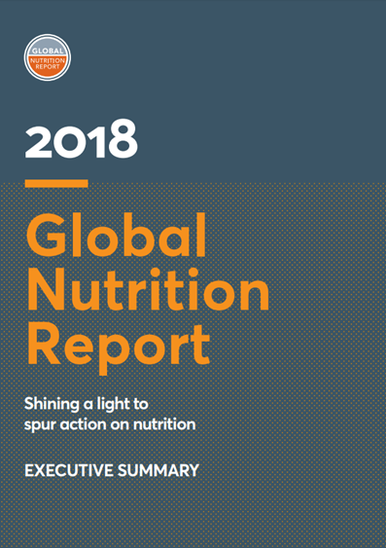
The Global Nutrition Report
The Global Nutrition Report (GNR) was conceived of, following the first Nutrition for Growth (N4G) summit in 2013, to track progress against global nutrition targets along with the financing, commitments and actions designed to reach them.
Vision A world free from malnutrition in all its forms.
Mission The Global Nutrition Report drives greater action to end malnutrition in all its forms.
Notes:
Highlight the GNR has existed since 2014 to keep track of progress to end malnutrition in all it’s forms
Stress the GNR is the world’s leading independent assessment on the state of global nutrition
Highlight the GNR does this by providing data, analysis and expert opinion to help drive action where it is urgently needed
Stress the GNR is a unifying voice, designed for and with the communities who can act
Clarify this presentation combines information from the 2018 GNR report and new data from our updated Country Nutrition Profiles & N4G commitment tracking tool (both available on our website)

Slide 4
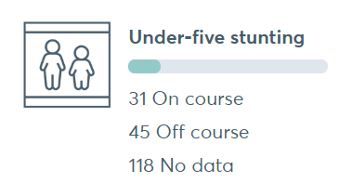
The global picture
Source: Global Nutrition Report, 2019. Country Nutrition Profiles: Global.
Not a single country in the world is on course to meet global nutrition targets for adult obesity or anaemia in women of reproductive age.
Notes:
Highlight the GNR’s global nutrition profile is based on the latest available data.
It provides a concise overview of the current state of nutrition at the global level
Stress malnutrition is a universal issue that affects every country on the planet – no country is untouched
Stress despite some progress, the world is off course to meet global nutrition targets
Highlight point on under-five stunting: 149.0m (2018)
Highlight point on adult obesity: Adult obesity: 677.6m - 284.1m men, 393.5m women (2016)
As we can see from this overview, the need for more data is crucial to building a more accurate picture of the global burden of malnutrition.

Slide 5
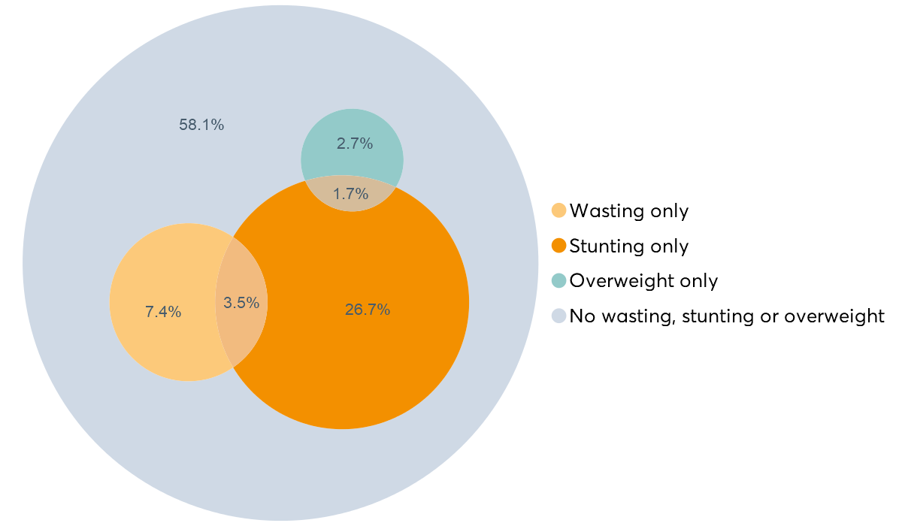
Coexistence of wasting, stunting and overweight in under-fives
3.5% of children are stunted and wasted
1.7% of children are stunted and overweight
Source: Global Nutrition Report, 2019. Country Nutrition Profiles: Global.
Notes: Percentage of children under-five years of age who experience different and overlapping forms of malnutrition. Based on population weighted means of 111 countries.
Notes:
Stress recent estimates indicate 3.5% of under-fives are both stunted and wasted, and 1.7% of under-fives are both stunted and overweight.
Highlight there is a high mortality risk associated with the coexistence of stunting and wasting.
Stress this means we must continue to make this a priority issue for urgent action.
Highlight stunting is the most prevalent form of child growth failure across all years and countries – but we are seeing some progress.

Slide 6
What progress have we made?
Notes:
We have seen a snapshot of the global picture.
Now let’s take a closer look at the data…

Slide 7
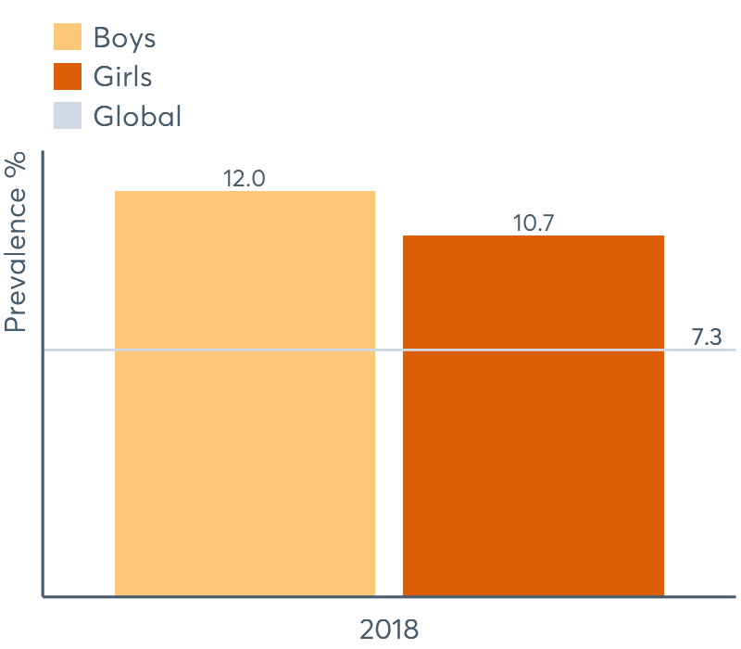
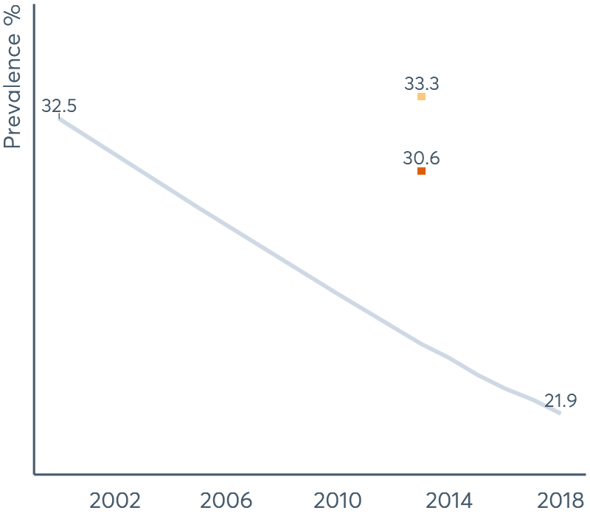
Globally, stunting and wasting in under-fives is declining
Wasting by gender
Stunting by gender
Source: Global Nutrition Report, 2019. Country Nutrition Profiles: Global.
Notes:
Stress there is hope - progress is being made to bring down levels of stunting and wasting.
Highlight the number of under-fives affected by stunting declined from 198.2m in 2000 to 149m in 2018.
*Difference in data points for global and dissagregated by gender due to different sources (as explained in notes in the online version):
Notes: Global trends (grey line in charts) refer to estimates from UNICEF/WHO/World Bank Group: Joint child malnutrition estimates. Disaggregated data (coloured lines/bars in charts) is based on population weighted means. Estimates are presented only where available data represents at least 50% of the regional population. Based on population weighted means of between 83 and 110 countries.
Wasting affected an estimated 50.5m in 2017. This decreased to 49.5m in 2018.
Stress the inclusion levels of progress differs significantly depending on gender, location, income, mother’s education and age.
Stress the prevalence is greater among boys in both cases.

Slide 8
Stunting has decreased globally to 21.9%
TARGET 1: 40% reduction in the number of children under 5 who are stunted
COUNTRY LEVEL PROGRESS:
Paraguay
48% reduction in stunting among under-fives since 2012, from 74,100* to 38,300* in 2016.
GLOBAL PROGRESS:
Thailand 39%* reduction in stunting among under-fives since 2012, from 657,000* in 2012 to 398,000* in 2016.
Source: Global Nutrition Report, 2019. Country Nutrition Profiles: Global.
*Numbers and percentages with an asterisk were updated on 21.11.2019 in line with updated UN population data.
Notes:
Stress examples from the country level show that accelerated progress towards global nutrition targets is possible.
Trends in stunting over time show significant progress in declining levels of stunting at the national level.
Highlight Paraguay almost cut in half national rates of stunting among children under-five within just four years.
State Thailand similarly cut its prevalence of stunting among children under-five by 40% within four years.

Slide 9
Exclusive breastfeeding has increased to 41.2%
TARGET 5:
Increase the rate of exclusive breastfeeding in the first 6 months to at least 50%
COUNTRY LEVEL PROGRESS:
Burkina Faso
Rates of exclusive breastfeeding rose from 6% to over 50% between 2006 and 2014.
GLOBAL PROGRESS:
India India achieved the exclusive breastfeeding target in 2015, rising from 46% in 2005 to 55% in 2015%.
Source: Global Nutrition Report, 2019. Country Nutrition Profiles: Global.
Notes:
Stress encouraging progress is also seen in the increased rates of exclusive breastfeeding in the first 6 months at the global and national level.
State rates of EBF in the first six months of a child’s life is increasing steadily. The global estimate for exclusive breastfeeding over the period 2013-2018 is 41.2%, whereas the global estimate for the period 2006-2010 was 37%.
Highlight the case of Burkina Faso demonstrates speedy progress towards global nutrition targets is possible - rates of EBF increased from 6% to over 50% in 8 years.
Highlight India met the EBF target in 2015 and surpassed the World Health Assembly target to reach 55% in XX.

Slide 10
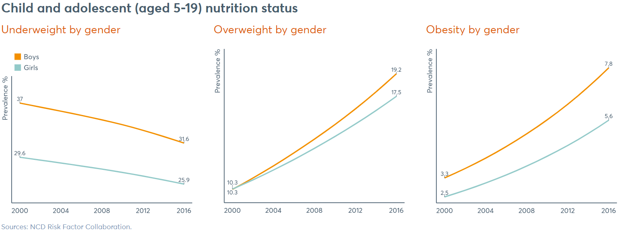
Progress to reduce malnutrition is inconsistent
Source: Global Nutrition Report, 2019. Country Nutrition Profiles: Global.
Notes:
Stress while we must recognise and learn from progress, we must also confront and explore persisting challenges.
Highlight estimates of malnutrition among children and adolescents (aged 5-19) reveal inconsistencies in progress to end malnutrition.
Stress decreasing rates of underweight contrast with significant rises in rates of overweight and obesity.
Stress boys experience higher rates of all three forms of malnutrition.
The rate of increase in overweight and obesity is also greater among boys.

Slide 11
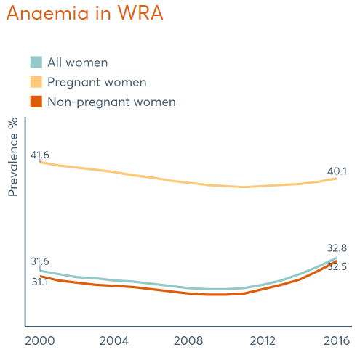
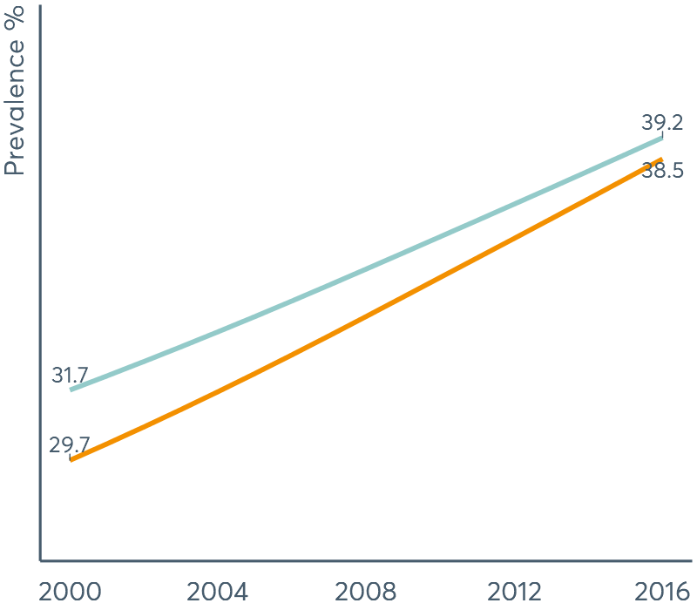
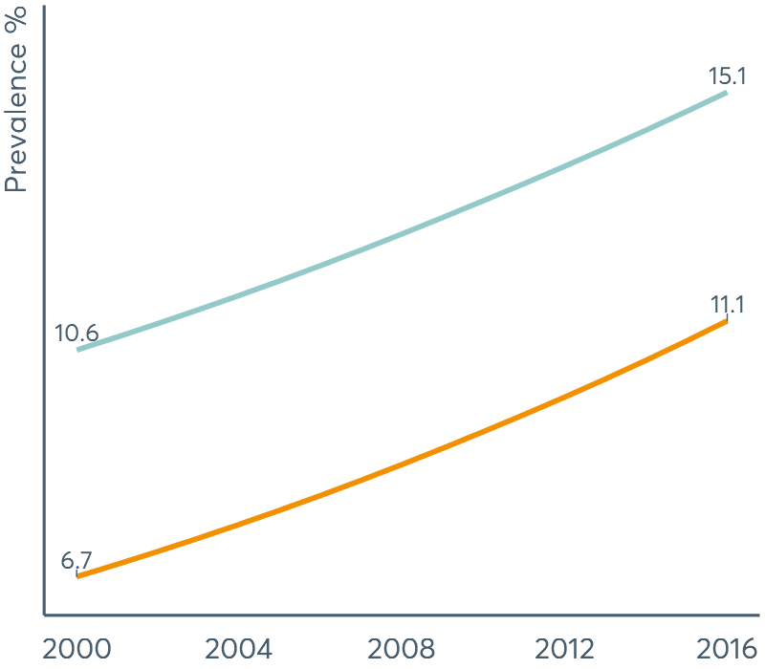
Anaemia, overweight and obesity in adults continues to rise
Source: Global Nutrition Report, 2019. Country Nutrition Profiles: Global.
Notes:
Highlight adult populations also experience a significant burden of malnutrition across the globe.
Stress although we see progress in declining rates of anaemia in pregnant women, among other women of reproductive age it is increasing.
Stress current trends in overweight and obesity are alarming and must be addressed as a matter of urgency if we are to meet global nutrition targets.
Note that women are more affected by overweight and obesity than men.
Ask ‘So where should we be focusing our attention to speed up progress in the race to end hunger and all forms of malnutrition?’

Slide 12
How can we speed up progress?
Notes:
State we can see there is progress, and this should be celebrated.
Stress this progress is directly linked to the efforts of countries striving to establish, apply and strengthen policies and programmes that tackle malnutrition in all its forms.
Highlight we have learnt and continue to learn from examples of effective policies and programmes.
Let’s look at some examples…

Slide 13
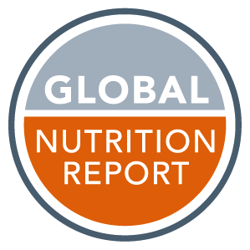
Evidence-based policies and programmes are key to speeding up progress
More countries have mandatory fortification
86 countries require at least one type of cereal grain to be fortified.
Governments are acting to improve diets
73 countries impose taxes on sugar-sweetened beverages.
Multi-sector action in cities is growing
Obesity among children of all age groups declined from 21% in 2012 to 18.5% in 2015 in Amsterdam, where the Healthy Weight Programme has been ongoing since 2012.
Multi-level, community-based interventions show rapid impact
In Ethiopia, minimum dietary diversity increased from 5.2% in 2015 to 24.9% in 2017 among children that participated in the Alive & Thrive Initiative.
The fortification of salt is increasing
Between 2014 and 2017, six countries passed new salt iodisation legislation.
Notes:
Stress the 2018 GNR presented many examples of policies and programmes that have proven to be effective.
These examples emphasize the need for greater action, as they demonstrate that positive and powerful change is achievable.
Highlight 73 countries now impose taxes on sugar-sweetened beverages – in Mexico, this change in legislation led spending on sugary drinks to decline by 9.7% within 2 years.
Mandatory fortification policies mean that only 19 countries still experience insufficient iodine intake – compared to 110 countries in 1993.
Highlight between 2014 and 2017, six countries passed new salt iodisation legislation.
Stress other programmes and policies proven to be effective include multi-sectoral, multi-level and community-based actions highlighted in the 2018 GNR.

Slide 14
Nutrition for Growth commitment tracking
7 out of 11 countries are on course to meet impact commitments.
14 out of 14 countries have met or are on course to meet policy commitments.
7 out of 10 countries are on course to meet programme commitments.
Malawi has met its commitment to develop a Nutrition Act and to scale up the coverage of community-based nutrition services.
Yemen reached its commitment to finalise a National SUN Plan, establish realistic targets and publish its nutrition spending.
Notes:
Highlight every year the GNR tracks commitments to end malnutrition made by stakeholders through the Global Nutrition for Growth (N4G) Compact.
Stress we have just launched our improved N4G tracking tool.
State the N4G commitment tracking tool provides the latest data on the status of commitments made by key stakeholders, including governments, civil society organisations, the private sector, the UN and donors.
Stress while there is a lot of progress to meet commitments, too many commitments are ‘off course’ and there are too many ‘no responses’.

Slide 15
Financial commitments
5 out of 11 countries have met or are on course to meet their financial commitments.
Malawi has made progress towards its commitment to increase the proportion of annual government expenditure allocated to nutrition.
Senegal has reached its commitment to increase funding for nutrition each year, allocating 6 billion in local currency in 2018.
Yemen is on course to establish new budget lines for nutrition programming in the ministries of Health, Water and Environment, as well as Food and Agriculture.
Notes:
Highlight accountability is key to driving action to end malnutrition in all its forms.
Stress in addition to policy, programme and impact commitments, the N4G commitment tracking tool on the GNR website also tracks progress against financial commitments by governments, donors and civil society organisations.
Stress the examples on the slide show the types of financial commitments made by governments to improve nutrition-related outcomes at the national level.
Mention the GNR’s N4G commitment tracking tool is also a useful tool for nutrition advocates and policy makers.
For example, the 2019 accountability report and scorecards developed by ACTION use the data in the N4G commitment tracking tool to point out what is needed to meet global goals for improved nutrition.

Slide 16
Notes:
Highlight, as Co-Chair of the GNR Independent Expert Group, Venkatesh Mannar, recently stated:
“It would be easy simply to blame governments or the private sector for the lack of action so far. […] The nutrition community must therefore leave its comfort zone and engage with decision-makers focusing on health, agriculture, climate change, and other big global issues.”

Slide 17
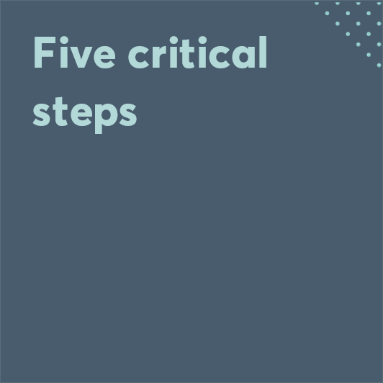
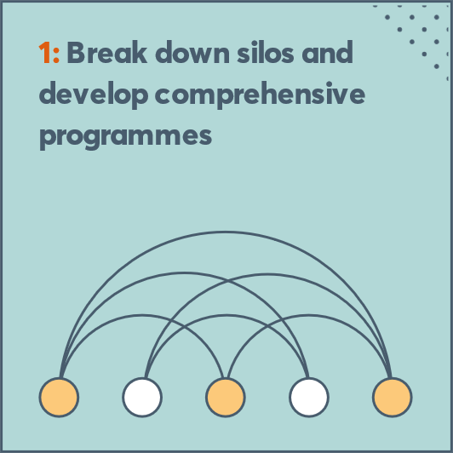
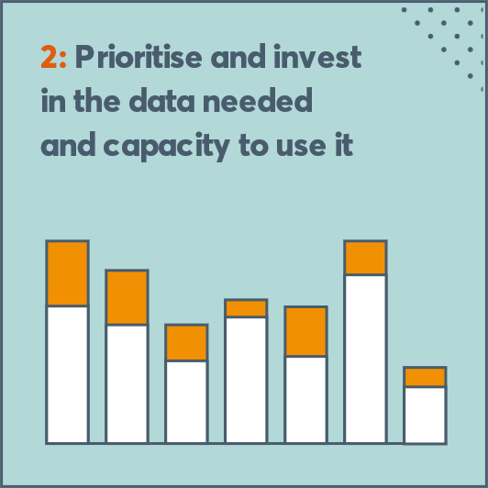
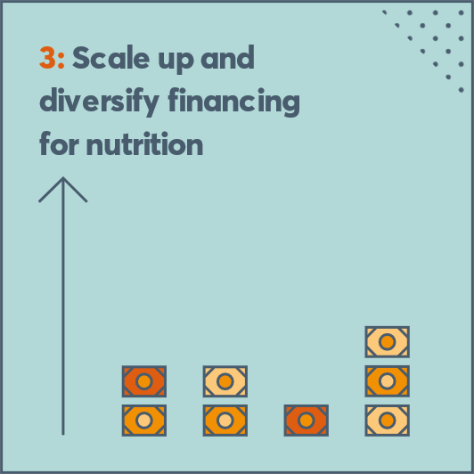
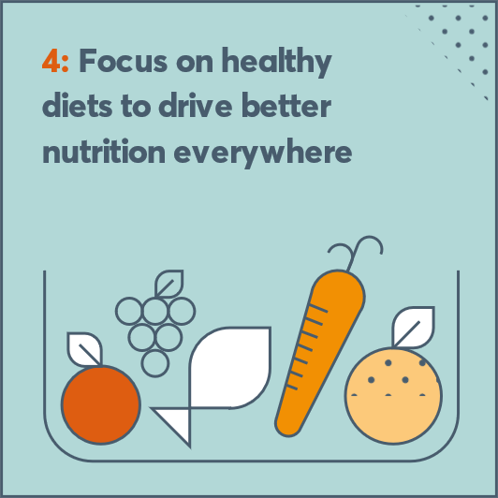
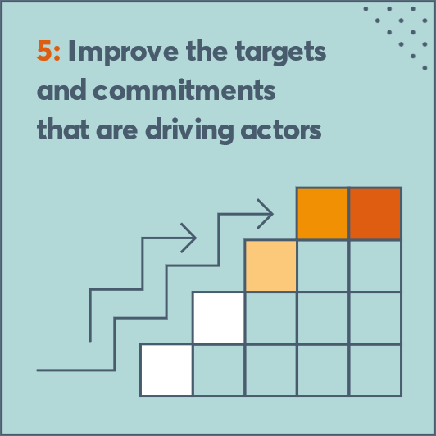
Notes:
Looking forward, we celebrate progress on targets and commitments made so far and the determination of countries to make progress, often in exceptionally challenging contexts.
We also recognize that progress to date has centered around undernutrition.
Stress much more action is needed to reverse alarming trends in the growth of overweight and obesity and related non communicable diseases.
Highlight the 2018 GNR proposed 5 critical steps, which are essential if we are to achieve global nutrition targets and end all forms of malnutrition.
Highlight ever increasing global data shows that inequities are key to addressing malnutrition.
The next Global Nutrition Report, which will be launched in March 2020, will unpack the role of inequities in ending malnutrition in all its forms.

Slide 18
Thank you
@GNReport
@globalnutritionreport
Development Initiatives Ltd North Quay House Quay side Temple Back Bristol BS1 6FL
globalnutritionreport.org
Notes:
Thank the audience and the SUN Global Gathering organisers again.
The GNR will be showcasing its Country Nutrition Profiles today at 1:45 in the Global Village.
Come along and meet with the GNR’s lead data analyst, Jordan Beecher, who can provide you with a personalised demonstration of your country profile.
Hand over to David Nabarro (moderator)

